Slide 1
Visual Genome: Connecting Language and Vision Using Crowdsourced Dense Image Annotations
2018.04.03 Lim, Doyeon

Slide 2
Needs for dataset
Cognitive task: image description, question answering → rich content in image is needed
“What vehicle is the person riding?” identify the objects and relationships is necessary e.g) riding(man, carriage) / pulling(horse, carriage)
Notes:
Despite progress in perceptual tasks such as image classification

Slide 3
Dataset structure
Dense annotations of objects, attributes, and relationships
108K images average 35 objects, 26 attributes, 21 pairwise relationship between objects → Canonicalize to WordNet synset
More than 50 descriptions per image average 17 question answer pair
Notes:
Despite progress in perceptual tasks such as image classification

Slide 4
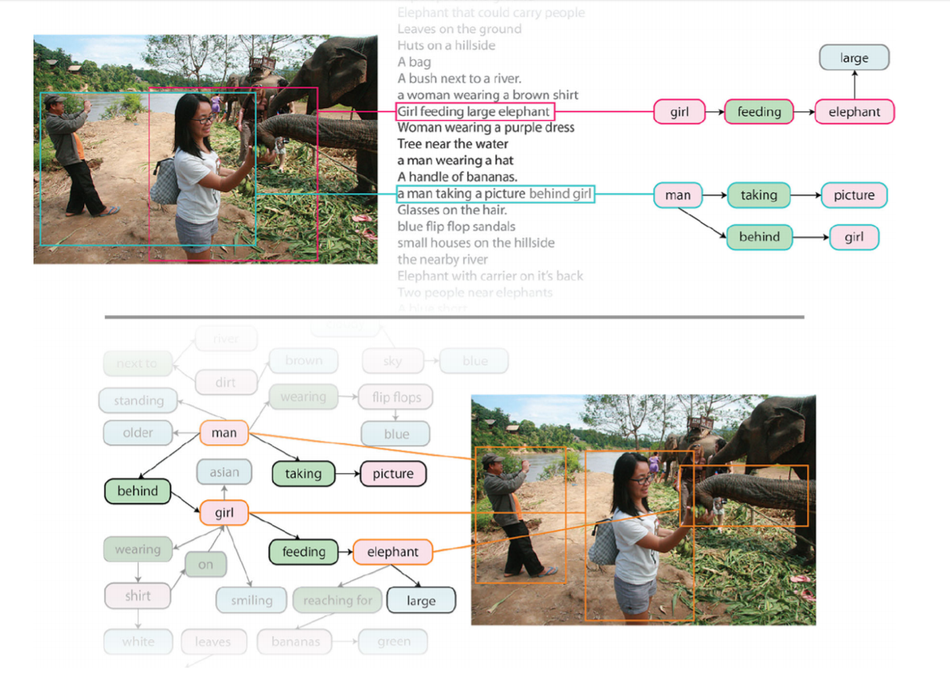
attribute
relation
object
Notes:
existing models would be able to detect discrete objects in a photo but would not be able to explain their interactions or the relationships between them
Region-based question answers can be used to jointly develop NLP and vision models

Slide 5
Three key elements & 7 components
Grounding of visual concepts to language
Complete set of descriptions and Qas
Formalized representation
region descriptions / objects / attributes / relationships / region graphs / scene graphs / question answer pairs.
Notes:
Despite progress in perceptual tasks such as image classification

Slide 6
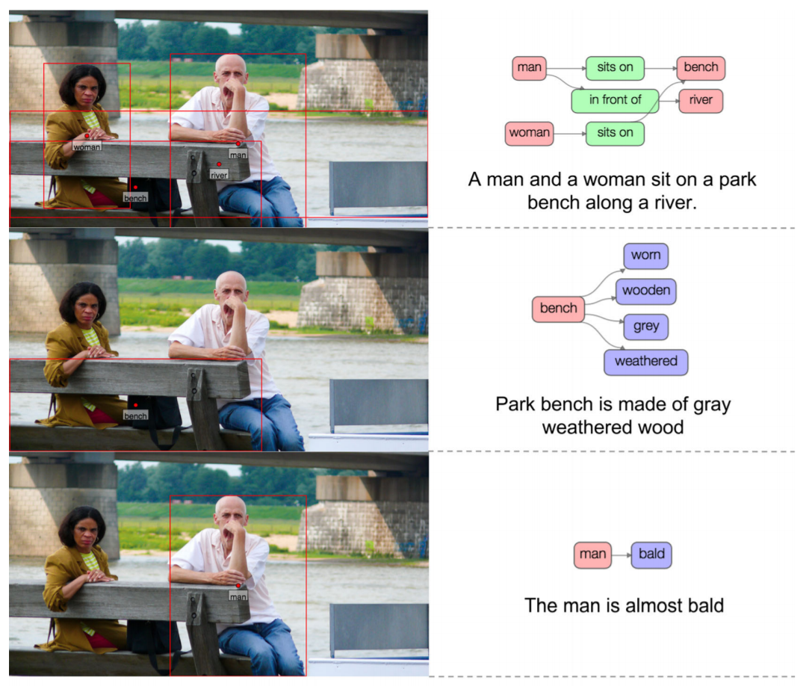
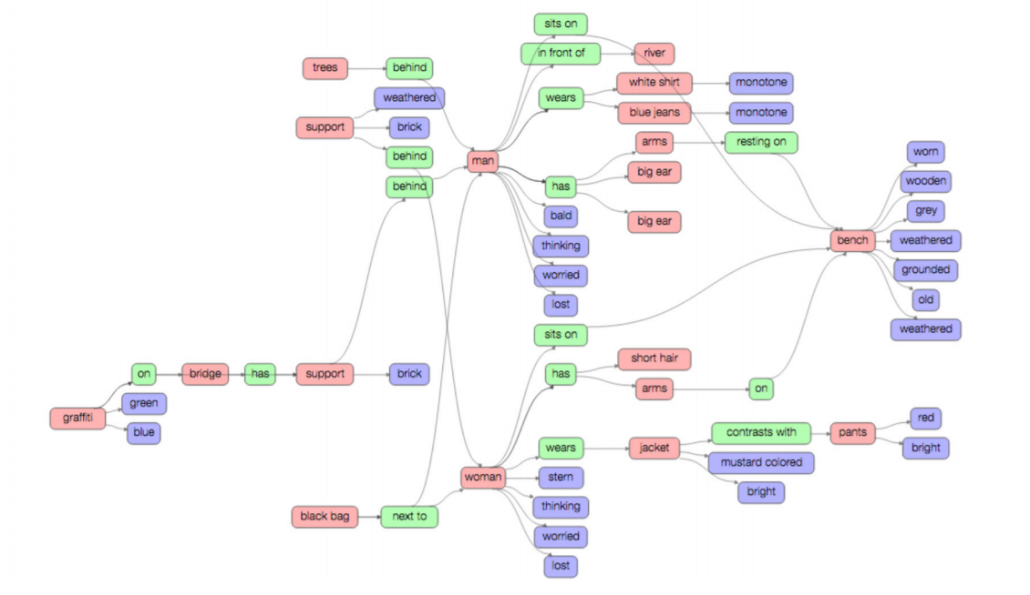
Data representation details
Multiple regions and Their Description
object
relation
attribute
Notes:
Overlap is possible

Slide 7
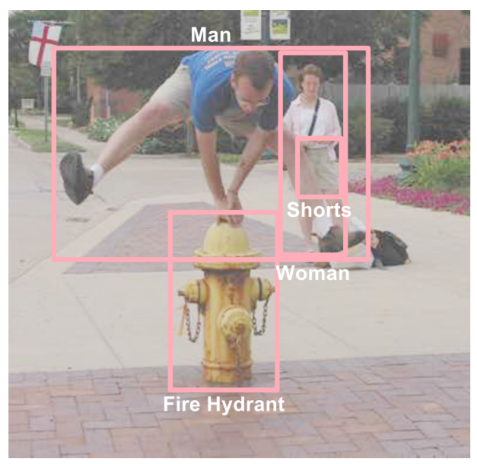
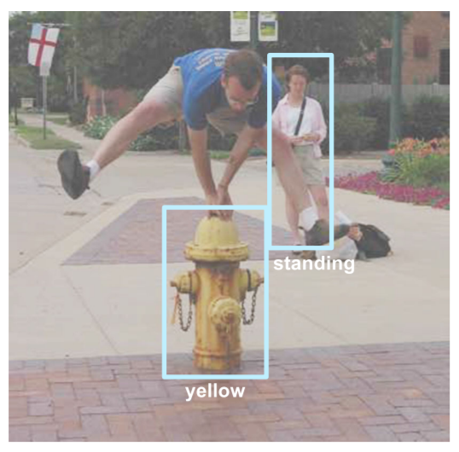
Data representation details
Multiple Objects and Their Bounding Boxes / Attributes
man.n.03 (the generic use of the word to refer to any human being)
Notes:
Despite progress in perceptual tasks such as image classification

Slide 8
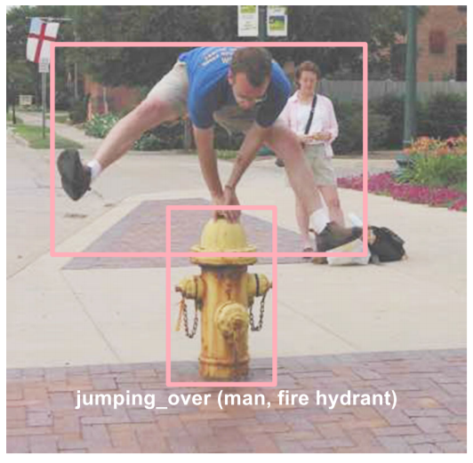
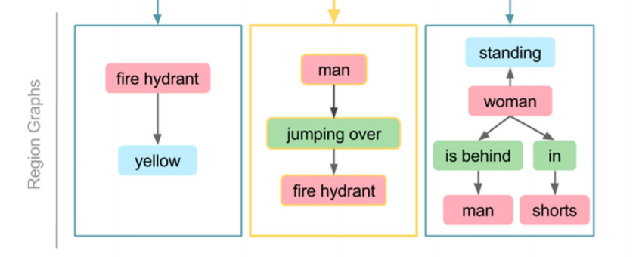
Data representation details
A Set of Relationships / Region Graph
Notes:
Despite progress in perceptual tasks such as image classification

Slide 9
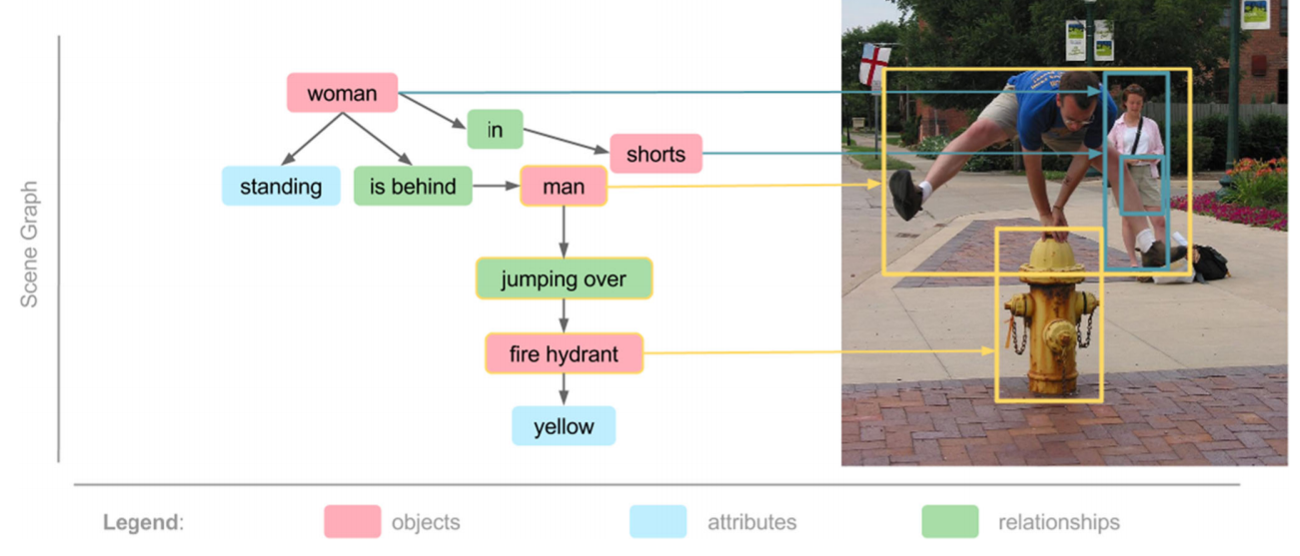
Data representation details
One Scene Graph
Notes:
Despite progress in perceptual tasks such as image classification

Slide 10
Data representation details
A Set of Question Answer Pairs → 6 different types: what, where,how,when,who, and why.
Freefrom QA Q.What is the woman standing next to? A. Her belongings
Region-based QA Q. What color is the fire hydrant? A. Yellow.
Notes:
Region based QAs are based on the description

Slide 11
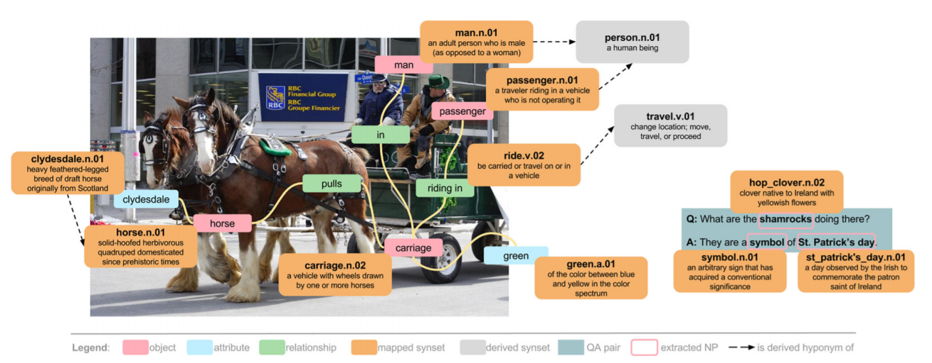
Data representation details
Notes:
Despite progress in perceptual tasks such as image classification

Slide 12
Crowdsourcing Strategies
Amazon Mechanical Turk
For first plain image, worker is asked to draw three bounding boxes and write three descriptions for the region enclosed by each box
Workers are asked to write descriptions that have not been written before
Repeated until 50 region descriptions are collected
Notes:
Region based QAs are based on the description

Slide 13
Crowdsourcing Strategies
To avoid writing similar description, show top 7 most similar descriptions to workers (BLEU score)
Image-Specific Descriptions
Global Image Descriptions (top 100 most common written descriptions of all images) e.g) sky is blue
Notes:
Region based QAs are based on the description

Slide 14
Crowdsourcing Strategies
Objects
a list of previously extracted objects as suggestions
Stanford’s dependency parser to extract nouns
Attributes, Relationships, and Region Graphs
Ask to add attributes to objects
Ask to connect pairs of objects with relationships
Scene Graphs
union of all region graphs extracted from region descriptions ( > 0.9 overlap) → ask to worker before merge
Notes:
To avoid call ‘man’ to ‘person’

Slide 15
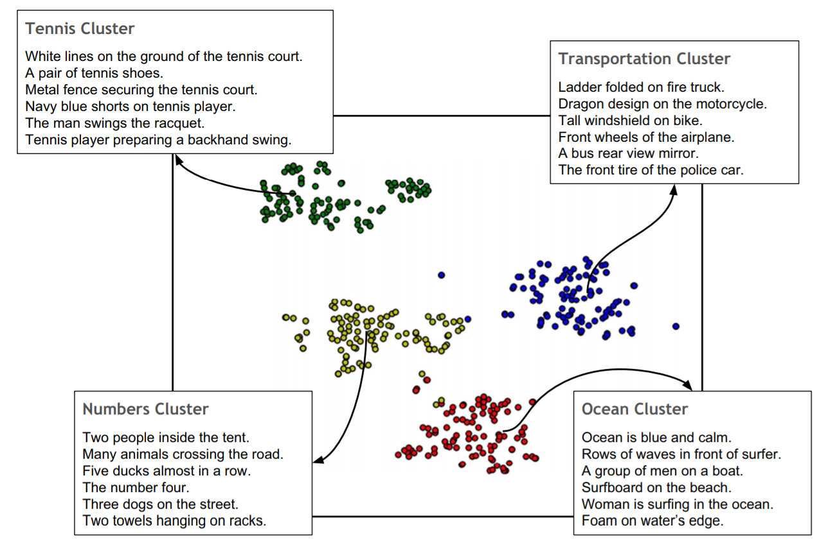
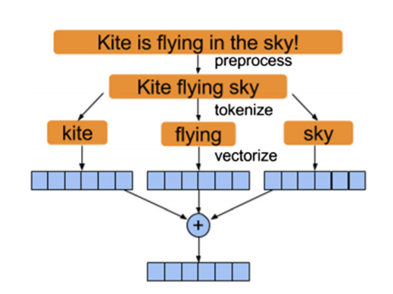
Dataset Statistics and Analysis
→ 71 clusters
Notes:
Images from MS-COCO, YFCC100M

Slide 16
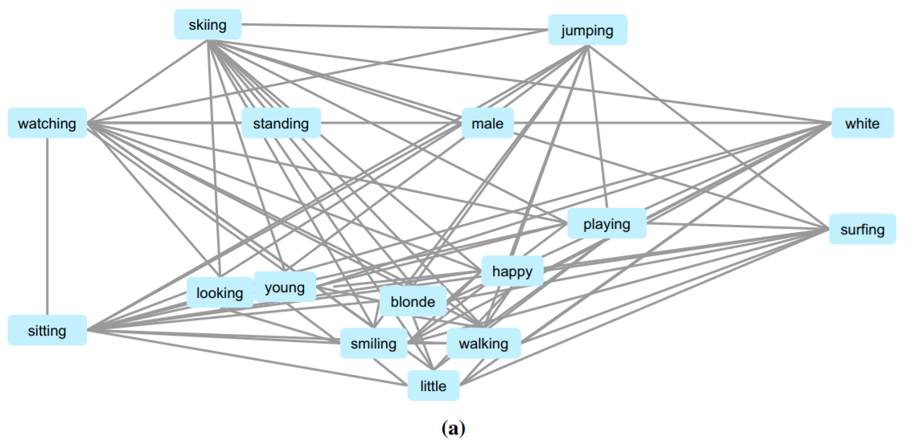
Dataset Statistics and Analysis
a Graph of the person-describing attributes with the most cooccurrences.
Notes:
Images from MS-COCO, YFCC100M

Slide 17
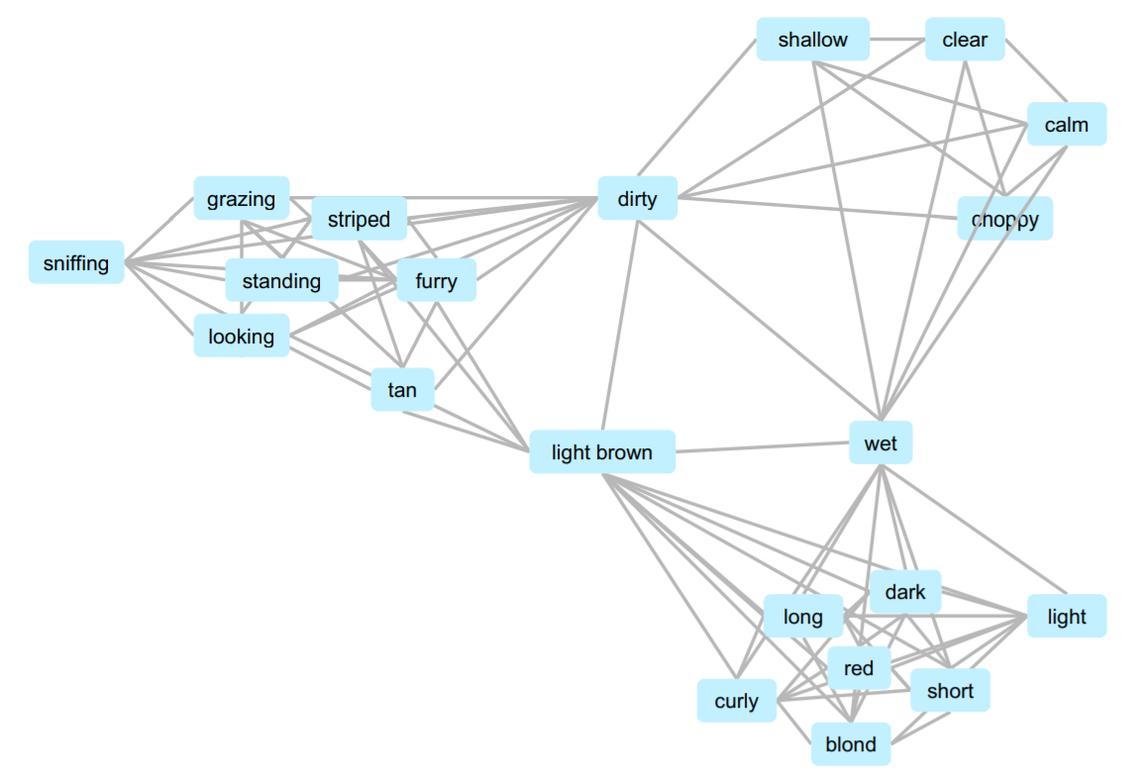
Dataset Statistics and Analysis
water
animal
A subgraph showing the co-occurrences and intersections of three cliques
hair
Notes:
Statistics for most common objects, relation, descriptions
Also statistics for QA is given

Slide 18
Application in our lab
Context embedding for description
Like WordNet Synset, this network can describe the characteristic of the word using the neighborhood (context) words
Making graph in Exobrain
Notes:
To avoid call ‘man’ to ‘person’

